Slide 1


3140705
Unit – 6 Exception Handling, I/O, Abstract Classes and Interfaces
Prepared By
Prof. Ravikumar Natarajan
Assistant Professor, CE Dept.

Slide 2
Introduction
Exception handling enables a program to deal with exceptional situations and continue its normal execution.
Ex. You divide a number with ‘0’. Division by 0 exception will occur and program will be terminated.
If you can handle this kind of exceptions then your program will continue its normal execution.

Slide 3
Exception-Handling Overview
Java’s exception-handling model is based on three operations:
Declaring an exception,
Throwing an exception, and
Catching an exception.
Exceptions are thrown from a method. The caller of the method can catch and handle the exception.

Slide 4
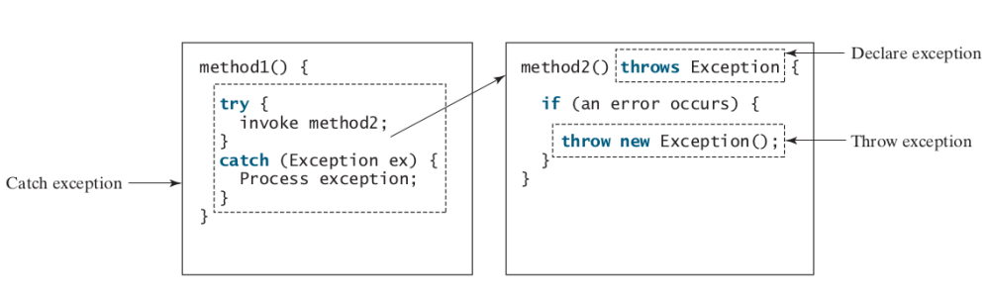
Exception-Handling Overview

Slide 5
Exception Types
Three types,
1. Checked Exception (Compile time)
These exceptions checked by the code itself. Using try-catch or throws i.e compiler will check these exceptions. From java.lang.Exception class.
Ex: IOException
2. Unchecked Exception (Run time)
These exceptions are not checked by compiler. JVM will check these exceptions. From java.lang.RuntimeException class.
Ex: ArrayIndexOutOfBounds, RunTimeException.
3. System Errors
System errors are thrown by the JVM and are represented in the
Error class. The Error class describes internal system errors, though such errors rarely occur.
Ex: LinkageError, VirtualMachineError

Slide 6
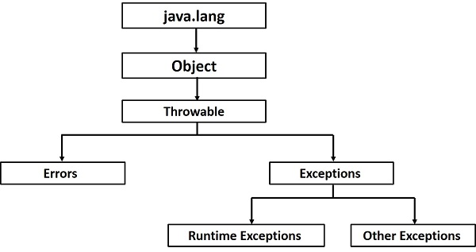
Exception Types

Slide 7
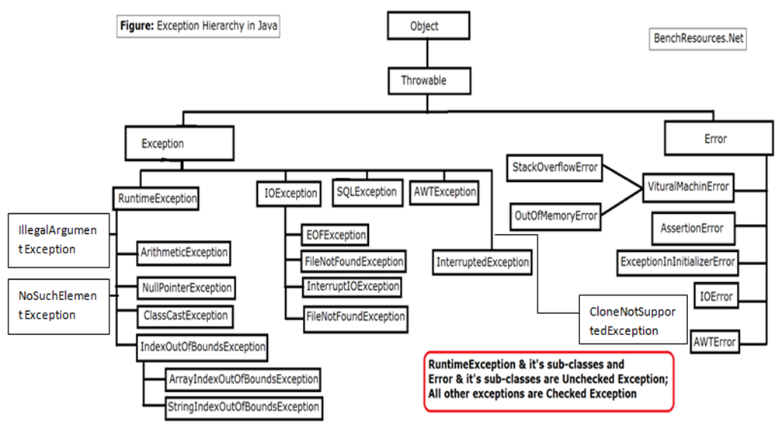
Exception Types

Slide 8
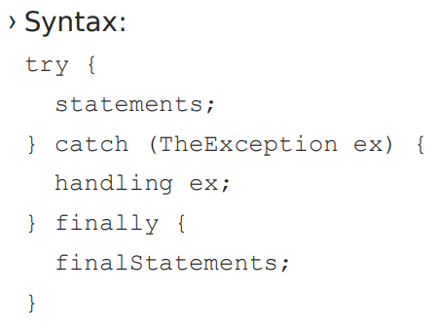
The finally Clause
The finally clause is always executed regardless whether an exception occurred or not.
You may want some code to be executed regardless of whether an
exception occurs or is caught.
Java has a finally clause that can be used to accomplish this objective.

Slide 9
Throwing and Catching Exceptions
Five keywords to handle exception,
1. Try – to monitor exception | to try critical block
2. Catch – handles specific exception with try block
3. Finally – code executed even exception may or may not occur. Denotes end of the program. | optional to use
4. Throw – used to throw specific exception
5. Throws - used to throw specific exception by a particular method.

Slide 10
Throwing and Catching Exceptions
Using Multiple Catch Clauses
To catch different types of exceptions multiple catch clause can be used.
Example:
public class TestMultipleCatchBlock{
public static void main(String args[]){
try{
int a[]=new int[5];
a[5]=30/0;
}
catch(ArithmeticException e){
System.out.println("task1 is completed");}
catch(ArrayIndexOutOfBoundsException e){
System.out.println("task 2 completed");}
catch(Exception e){
System.out.println("common task completed");}
System.out.println("rest of the code...");
} }
Output:task1 completed
rest of the code...

Slide 11
Throwing and Catching Exceptions
Try block can be nested
A try, catch or finally block can contain another set of try catch and finally sequence.
class Excep6{
public static void main(String args[]){
try{
try{
System.out.println("going to divide");
int b =39/0;
}catch(ArithmeticException e) {System.out.println(e);}
try{
int a[]=new int[5];
a[5]=4;
}catch(ArrayIndexOutOfBoundsException e) {System.out.println(e);}
System.out.println("other statement");
}catch(Exception e)
{System.out.println("handeled");} System.out.println("normal flow.."); }
Output:
going to divide
Java.lang. ArithmeticException: /by zero
Java.lang. ArrayIndexOutOfBoundsException: 5
Other statement
Normal flow..

Slide 12
Throwing and Catching Exceptions
try-catch-finally keyword
class myExeption
{ public static void main(String s[]){
int i=5, j=0;
System.out.println("Try started");
try
{
int temp = i/j;
System.out.println("Inside try");
}
catch(Exception e)
{
System.out.println("Inside catch");
System.out.println("Divide by 0");
}
finally
{
System.out.println("Finally block");
} } }
Output: try started
Inside catch
Divide by 0
Finally block

Slide 13
Throwing and Catching Exceptions
Using throw #UserDefined Exception #Explicit
public class Main
{
void checkAge(int age)
{ if(age<18)
throw new ArithmeticException("Not Eligible for voting"); //inside Method UserDefined
else
System.out.println("Eligible for voting");
}
public static void main(String args[])
{
Main obj = new Main();
obj.checkAge(13);
System.out.println("End Of Program");
}
}
Output:
Exception in thread "main" java.lang.ArithmeticException:
Not Eligible for voting
at Example1.checkAge(Example1.java:4)
at Example1.main(Example1.java:10)

Slide 14
Throwing and Catching Exceptions
Example using throws
public class Example1
{
int division(int a, int b) throws ArithmeticException //Method signature, Supports Multiple Exception
{ int t = a/b;
return t;
}
public static void main(String args[])
{
Example1 obj = new Example1();
try{
System.out.println(obj.division(15,0));
}
catch(ArithmeticException e)
{
System.out.println("You shouldn't divide number by zero");
}
}
}
Output:
You shouldn't divide number by zero

Slide 15
Rethrowing Exception
Sometimes we may need to rethrow an exception in Java. If a catch block cannot handle the particular exception it has caught, we can rethrow the exception. The rethrow expression causes the originally thrown object to be rethrown.
Java allows an exception handler to rethrow the exception if the handler cannot process the exception or simply wants to let its caller be notified of the exception.
The syntax for rethrowing an exception may look like this:
try {
statements;
} catch (TheException ex) {
perform operations before exits;
throw ex;
}

Slide 16

Rethrowing Exception
public class RethrowingExceptions
{ static void divide() {
int x,y,z;
try {
x = 6 ;
y = 0 ;
z = x/y ;
System.out.println(x + "/"+ y +" = " + z);
}
catch(ArithmeticException e)
{
System.out.println("Exception Caught in Divide()");
System.out.println("Cannot Divide by Zero in Integer Division");
throw e; // Rethrows an exception
}
}
public static void main(String[] args)
{
System.out.println("Start of main()");
try
{
divide();
}
catch(ArithmeticException e)
{
System.out.println("Rethrown Exception Caught in Main()");
System.out.println(e);
}
}
}

Slide 17
Chained Exception
Throwing an exception along with another exception forms a chained exception.
Example
// the catch block of method1
catch (Exception ex) { ex.printStackTrace(); }
// the catch block of method2
catch (Exception ex) {
throw new Exception("New info from method1", ex);
}

Slide 18
Chained Exception
The Throwable class has methods which support exception chaining −
Method | Description
getCause() | Returns the original cause of the exception
initCause(Throwable cause) | Sets the cause for invoking the exception
public class Example {
public static void main(String[] args) {
try {
// creating an exception
ArithmeticException e = new ArithmeticException("Apparent cause");
// set the cause of an exception
e.initCause(new NullPointerException("Actual cause"));
// throwing the exception
throw e;
} catch(ArithmeticException e) {
// Getting the actual cause of the exception
System.out.println(e.getCause()); } } }

Slide 19
Defining Custom Exception Classes
You can define a custom exception class by extending the java.lang.Exception class.
You can use exception classes provided by Java, whenever it is appropriate.
If you run into a problem that cannot be adequately described by the predefined exception classes, you can create your own exception class.
Custom Exception Class must be derived from Exception or from a subclass of Exception, such as IOException.

Slide 20
Defining Custom Exception Classes
class CustomException extends Exception {
String message;
CustomException(String str) {
message = str;
}
public String toString() {
return ("Custom Exception Occurred : " + message);
}
}
public class MainException {
public static void main(String args[]) {
try {
throw new CustomException("This is a custom message");
} catch(CustomException e) {
System.out.println(e); } } }

Slide 21
File Handling
A file is a sequence of records stored in binary format. A disk drive is formatted into several blocks that can store records. File records are mapped onto those disk blocks.
A file is an object on a computer that stores data, information, settings, or commands used with a computer program.
To obtain properties of file/directory.
To delete file/directory.
To rename file/directory.
To create directory.
To read File.
To write File.
Absolute vs. Relative File Name

Slide 22
Absolute vs Relative File Name
An absolute file name (or full name) contains a file name with its
complete path.
Absolute file names are machine dependent.
For example,
Windows: D:\MEFGI\Oop1.java
directory path: D:\MEFGI, file name: Oop1.java
UNIX: /home/tejas/MEFGI/Oop1.java
directory path: /home/tejas/MEFGI, file name: Oop1.java
A relative file name is in relation to the current working directory.
The complete directory path for a relative file name is omitted.
For example, Oop1.java is a relative file name.

Slide 23
Absolute vs Relative File Name
An absolute file name (or full name) contains a file name with its
complete path.
Absolute file names are machine dependent.
For example,
Windows: D:\MEFGI\Oop1.java
directory path: D:\MEFGI, file name: Oop1.java
UNIX: /home/tejas/MEFGI/Oop1.java
directory path: /home/tejas/MEFGI, file name: Oop1.java
A relative file name is in relation to the current working directory.
The complete directory path for a relative file name is omitted.
For example, Oop1.java is a relative file name.

Slide 24
File Handling
Use the File class to obtain file/directory properties, to delete and
rename files/directories, and to create directories.
Use the Scanner class for reading text data from a file.
Use the PrintWriter class for writing text data to a file.

Slide 25
File Class
File class is in java.io package.
The File class is intended to provide an abstraction that deals with most of the machine-dependent complexities of files and path names in a machine-independent fashion.
The File class contains the methods for obtaining the properties of a file/directory and for renaming and deleting a file/directory.
However, the File class does not contain the methods for reading and writing file contents.

Slide 26
The File Class
› File Constructors
› exists() method
› canRead() method
› isDirectory() method
› isFile() mthod
› isAbsolute() method
› isHidden() method
› getAbsolutePath() method
› getName() method
› getPath() method
› getParent() method
› lastModified() method
› length() method
› listFile() method
› delete() method
› renameTo() method
› mkdir() method

Slide 27
The Scanner Class
› Scanner(source: File) // Creates a Scanner that scans tokens from the specified file.
› Scanner(source: String) // Creates a Scanner that scans tokens from the specified string.
› close() // Closes this scanner.
› hasNext(): boolean // Returns true if this scanner has more data to be read.
› next(): String // Returns next token as a string from this scanner.
› nextLine(): String // Returns a line ending with the line separator from this scanner.

Slide 28
The Scanner Class
› nextByte(): byte // Returns next token as a byte from this scanner.
› nextShort(): short // Returns next token as a short from this scanner.
› nextInt(): int // Returns next token as an int from this scanner.
› nextLong(): long // Returns next token as a long from this scanner.
› nextFloat(): float // Returns next token as a float from this scanner.
› nextDouble(): double // Returns next token as a double from this scanner

Slide 29
The Scanner Class
› nextByte(): byte // Returns next token as a byte from this scanner.
› nextShort(): short // Returns next token as a short from this scanner.
› nextInt(): int // Returns next token as an int from this scanner.
› nextLong(): long // Returns next token as a long from this scanner.
› nextFloat(): float // Returns next token as a float from this scanner.
› nextDouble(): double // Returns next token as a double from this scanner

Slide 30
Byte streams and character streams
Stream is a channel in which data flow from sender to receiver.
Sequence of objects and methods pipelined together to produce results.
An input object reads the stream of data from a file is called input stream.
The output object writes the stream of data to a file is called output stream.
These classes are found in java.IO package.

Slide 31
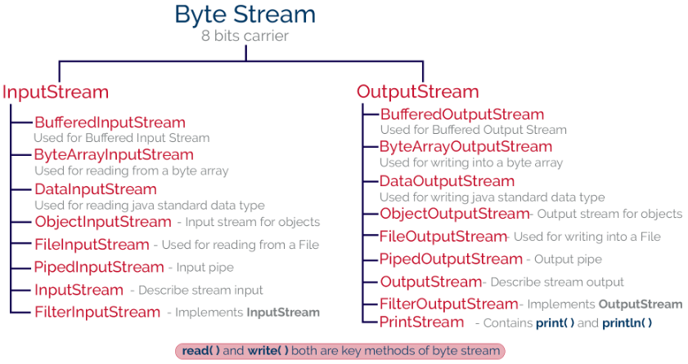
Byte Stream

Slide 32
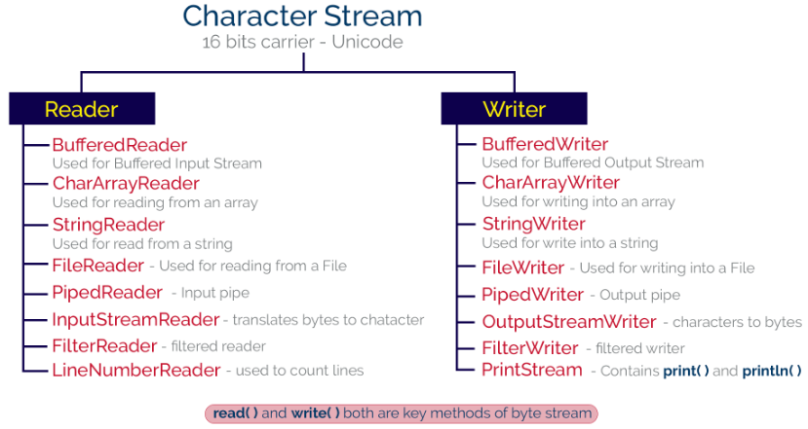
Character Stream

Slide 33
Read and write operations on file using InputStream and OutputStream
//To write into a file using byte stream
import java.io.*;
class output
{public static void main(String args[])
{ String s ="This is my file";
int a=5;
Double d=5.35;
try
{
FileOutputStream fos= new FileOutputStream("abcd.txt");
DataOutputStream dos = new DataOutputStream(fos);
dos.writeBytes(s);
dos.writeInt(a);
dos.writeDouble(d);
dos.close();
}
catch(IOException ex)
{ex.printStackTrace();}
}}

Slide 34
Read and write operations on file using InputStream and OutputStream
//To read from a file using byte stream
import java.io.*;
class input
{public static void main(String args[])
{
try
{ FileInputStream fin= new FileInputStream("abcd.txt"); //to read data from a file in bytes
DataInputStream din = new DataInputStream(fin); // read primitive Java data types
String line=null;
while((line =din.readLine())!=null)
{
System.out.println(line);
}
din.close();
}
catch(Exception ex)
{ex.printStackTrace();}
}}

Slide 35
FileWriter and FileReader
//To read from a file using character stream
import java.io.*;
class readerDemo
{
public static void main(String[] args)
{
try
{
File f1= new File("abc.txt");
FileReader fr = new FileReader(f1);
BufferedReader br=new BufferedReader(fr); //chaining
String line=null;
while((line=br.readLine()) !=null)
{
System.out.println(line);
}
br.close();
}
catch(Exception ex)
{ex.printStackTrace();} }}
//To write into a file using character stream
import java.io.*;
class writerDemo
{
public static void main(String[] args)
{
try
{
FileWriter fw = new FileWriter("abc.txt");
fw.write("Hello, Good Morning"); // fw.write("123");
fw.close();
}
catch(IOException ex)
{ex.printStackTrace();}
}}

Slide 36
Example 2
For Reference

Slide 37
PrintWriter and Reader
import java.io.PrintWriter;
class Main {
public static void main(String[] args) {
String data = "This is a text inside the file.";
try {
PrintWriter output = new PrintWriter(“PQR.txt");
output.print(data);
output.close();
}
catch(Exception e) {
e.getStackTrace();
}
}
}
import java.io.*;
public class ReaderExample {
public static void main(String[] args) {
try {
Reader reader = new FileReader(“PQR.txt");
int data = reader.read();
while (data != -1) {
System.out.print((char) data);
data = reader.read();
}
reader.close();
} catch (Exception ex) {
System.out.println(ex.getMessage());
}
}
}

Slide 38
ByteStream VS CharacterStream
Character streams
Byte streams
Meant for reading or writing to character- or text-based I/O such as text files, text documents, XML, and HTML files.
Data dealt with is 16-bit Unicode characters.
Input and output character streams are called readers and writers, respectively.
The abstract classes of Reader and Writer and their derived classes in the java.io package provide support for character streams.
Meant for reading or writing to binary data I/O such as executable files, image files, and files in low-level file formats such as .zip, .class, .obj and .exe.
Data dealt with is bytes (i.e., units of 8-bit data).
Input and output byte streams are simply called input streams and output streams, respectively.
The abstract classes of Input Stream and Output Stream and their derived classes in the java.io package provide support for byte streams.

Slide 39
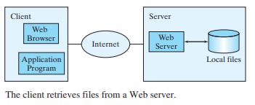
Reading Data from the Web
Just like you can read data from a file on your computer, you can read data from a file on the Web.
You can also access data from a file that is on the Web if you know the file’s URL (Uniform Resource Locator—the unique address for a file on the Web).
For example, www.google.com/index.html is the URL for the file index.html located on the Google Web server.

Slide 40
Reading Data from the Web
For an application program to read data from a URL, you first need to create a URL object using the java.net.URL class with this constructor:
public URL(String spec) throws MalformedURLException
try {
URL url = new URL("http://www.google.com/index.html");
}
catch (MalformedURLException ex)
{ ex.printStackTrace();
}

Slide 41
Reading Data from the Web
For an application program to read data from a URL, you first need to create a URL object using the java.net.URL class with this constructor:
public URL(String spec) throws MalformedURLException
try {
URL url = new URL("http://www.google.com/index.html");
}
catch (MalformedURLException ex)
{ ex.printStackTrace();
}

Slide 42
Reading Data from the Web
import java.net.*;
import java.io.*;
public class ReadURL {
public static void main(String[] args) throws Exception {
URL url = new URL("http://www.google.com/index.html");
BufferedReader read = new BufferedReader(
new InputStreamReader(url.openStream()));
String i;
while ((i = read.readLine()) != null)
System.out.println(i);
read.close();
}}

Slide 43
Abstract Class VS Interface
Refer previous unit for examples.
Parameters | Interface | Abstract class
Speed | Slow | Fast
Multiple Inheritances | Implement several Interfaces | Only one abstract class
Structure | Abstract methods | Abstract & concrete methods
When to use | Future enhancement | To avoid independence
Inheritance/ Implementation | A Class can implement multiple interfaces | The class can inherit only one Abstract Class
Data fields | the interface cannot contain data fields. | the class can have data fields.
Abstract keyword | In an abstract interface keyword, is optional for declaring a method as an abstract. | In an abstract class, the abstract keyword is compulsory for declaring a method as an abstract.

Slide 44
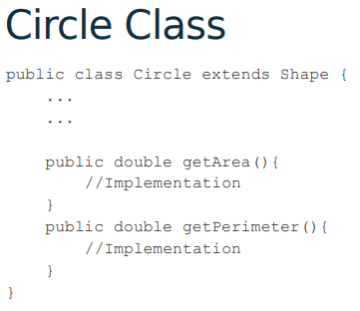
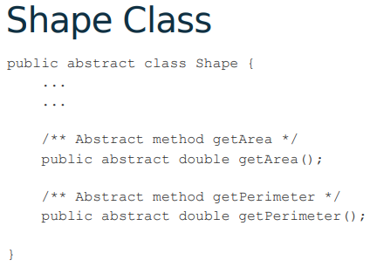
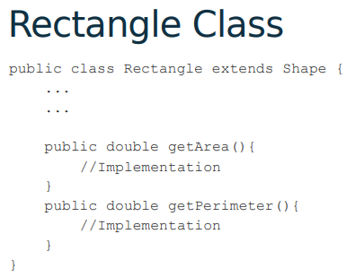
Abstract Class Example
Ex.: Shape (superclass), Circle and Rectangle (subclass)
Main Class
Class main{
Circle c = new circle();
Rectangle r = new Rectangle(); }

Slide 45
Interface
Since abstract class allows concrete methods as well, it does not provide 100% abstraction.
You can say that it provides partial abstraction.
Interfaces are used for 100% abstraction (full abstraction)
Syntax:
modifier interface InterfaceName {
/** Constant declarations */
/** Abstract method signatures */
}

Slide 46
The Comparable Interface
Suppose you want to design a generic method to find the larger of two objects of the same type, such as two students / dates / circles / rectangles / etc.
In order to accomplish this, the two objects must be comparable, so the common behavior for the objects must be comparable.
Java provides the Comparable interface for this purpose.
The Comparable interface defines the compareTo method for comparing objects.
The interface is defined as follows:
package java.lang;
public interface Comparable<E> {
public int compareTo(E o);
}

Slide 47
The Comparable Interface
The Comparable interface is a generic interface.
The generic type E [Comparable<E>] is replaced by a concrete type when implementing this interface.
class circle implements Comparable<Circle> {
public int compareTo(Circle o){
...
}
}

Slide 48
The Comparable Interface SortComparableObjects
import java.math.*;
public class Main {
public static void main(String[] args) {
String[] cities = {"Savannah", "Boston", "Atlanta", "Tampa"};
java.util.Arrays.sort(cities);
for (String city: cities)
System.out.print(city + " ");
System.out.println();
BigInteger[] hugeNumbers = {new BigInteger("2323231092923992"),
new BigInteger("432232323239292"),
new BigInteger("54623239292")};
java.util.Arrays.sort(hugeNumbers);
for (BigInteger number: hugeNumbers)
System.out.print(number + " ");
} }
Output:
Atlanta Boston Savannah Tampa
54623239292 432232323239292 2323231092923992

Slide 49
The Comparable Interface
class Student implements Comparable<Student>{
int rollno;
String name;
int age;
Student(int rollno,String name,int age){
this.rollno=rollno;
this.name=name;
this.age=age;
}
public int compareTo(Student st){
if(age==st.age)
return 0;
else if(age>st.age)
return 1;
else
return -1;
}
}
import java.util.*;
public class TestSort2{
public static void main(String args[]){
ArrayList<Student> al=new ArrayList<Student>();
al.add(new Student(101,"Vijay",23));
al.add(new Student(106,"Ajay",27));
al.add(new Student(105,"Jai",21));
Collections.sort(al);
for(Student st:al){
System.out.println(st.rollno+" "+st.name+" "+st.age);
}
}
}

Slide 50
The Cloneable Interface
Often it is desirable to create a copy of an object. To do this, you need to use the clone method and understand the Cloneable interface.
The Cloneable interface specifies that an object can be cloned.
An interface contains constants and abstract methods, but the Cloneable interface is a special case. The Cloneable interface in the java.lang package is defined as follows:
package java.lang;
public interface Cloneable {
}
This interface is empty. An interface with an empty body is referred to as a marker interface. A marker interface does not contain constants or methods. It is used to denote that a class possesses certain desirable properties. A class that implements the Cloneable interface is marked cloneable, and its objects can be cloned using the clone() method defined in the Object class.

Slide 51
The Cloneable Interface
package java.lang;
public interface Cloneable {
}
This interface is empty. An interface with an empty body is referred to as a marker interface.
A marker interface does not contain constants or methods. It is used to denote that a class possesses certain desirable properties.
A class that implements the Cloneable interface is marked cloneable, and its objects can be cloned using the clone() method defined in the Object class.
Many classes in the Java library (e.g., Date, Calendar, ArrayList etc.) implement Cloneable. Thus, the instances of these classes can be cloned.

Slide 52
The Cloneable Interface
Creating Copy of Java Object
We can create a replica or copy of java object by
Creating a copy of object in a different memory location. This is called a Deep copy.
Creating a new reference that points to the same memory location. This is also called a Shallow copy.

Slide 53
The Cloneable Interface
//DeepCopy
class Main implements Cloneable
{
public int x = 30;
public static void main(String args[])
{
Main obj1 = new Main();
// it will copy the reference, not value
//SCopy obj2 = obj1;
try{
Main obj2 = (Main)obj1.clone();
obj2.x = 6;
System.out.println("The value of x is: " + obj1.x);
System.out.println("The value of x is: " + obj2.x);
}
catch(Exception e){System.out.println(e);}
} }
//ShallowCopy
class Main
{
int x = 30;
public static void main(String args[])
{
Main obj1 = new Main();
// it will copy the reference, not value
Main obj2 = obj1;
obj2.x = 6;
System.out.println("The value of x is: " + obj1.x);
} }

Slide 54
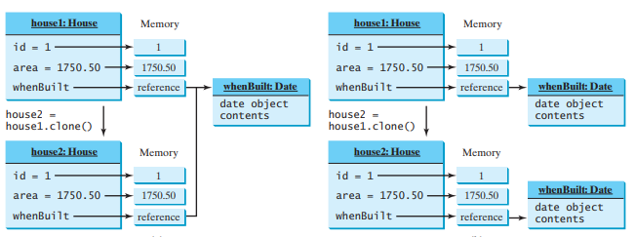
The Cloneable Interface
Shallow Copy
Deep Copy

Slide 55

Reference Programs

Slide 56
Reading Data from the Web
import java.util.Scanner;
public class ReadFileFromURL {
public static void main(String[] args) {
System.out.print("Enter a URL: ");
String URLString = new Scanner(System.in).next();
try {
java.net.URL url = new java.net.URL(URLString);
int count = 0;
Scanner input = new Scanner(url.openStream());
while (input.hasNext()) {
String line = input.nextLine();
count += line.length();
}
System.out.println("The file size is " + count + " characters");
}
catch (java.net.MalformedURLException ex) {
System.out.println("Invalid URL");
}
catch (java.io.IOException ex) {
System.out.println("I/O Errors: no such file");
}
}
}

Slide 57
ByteStream VS CharacterStream
import java.io.*;
class CopyFile
{
public static void main(String args[])
{
try
{
FileInputStream fr = new FileInputStream("photo.jpg");
FileOutputStream fw = new FileOutputStream("Copy.jpg");
int i =0;
while ((i=fr.read())!=-1){
fw.write(i);
}
fw.flush();
fw.close();
fr.close();
System.out.println("File copied successfully.......");
}
catch(Exception e)
{
System.out.println(e);
}
}
}

Slide 58
ByteStream VS CharacterStream
import java.io.*;
class CopyFile
{
public static void main(String args[])
{
try
{
FileReader fr = new FileReader("Data.txt");
FileWriter fw = new FileWriter("Copy.txt");
int i =0;
while ((i=fr.read())!=-1){
fw.write(i);
}
fw.flush();
fw.close();
fr.close();
System.out.println("File copied successfully.......");
}
catch(Exception e)
{
System.out.println(e); } } }

Slide 59
END OF UNIT - 6

